Slide 1
Resequencing pipeline using Samtools and vcftools

Slide 2
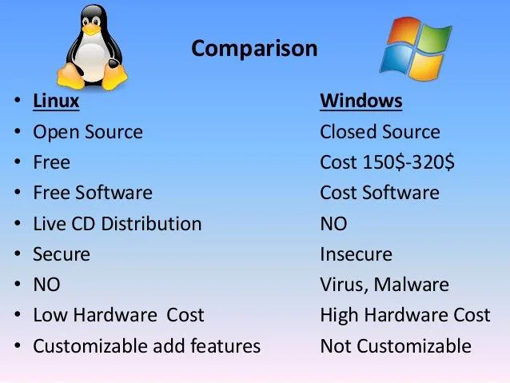
Linux OS

Slide 3
Connecting to server
Download putty
Server connection practice
ssh ID@address
ID : vietnam
PW : snu123
Address : 147.46.250.193

Slide 4
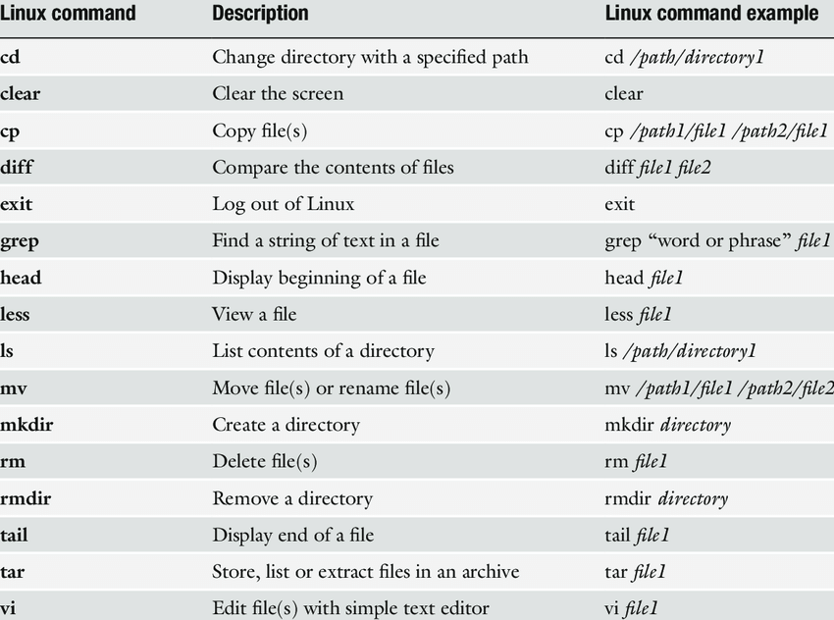
Basic command in Linux

Slide 5
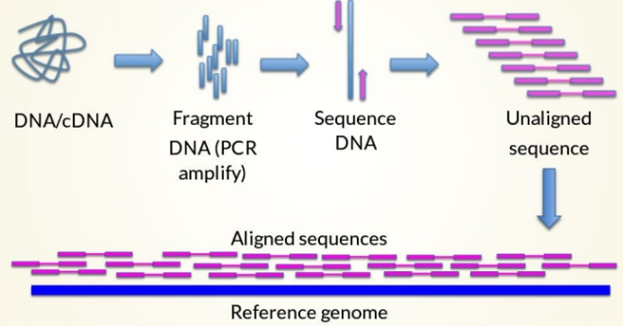

Slide 6
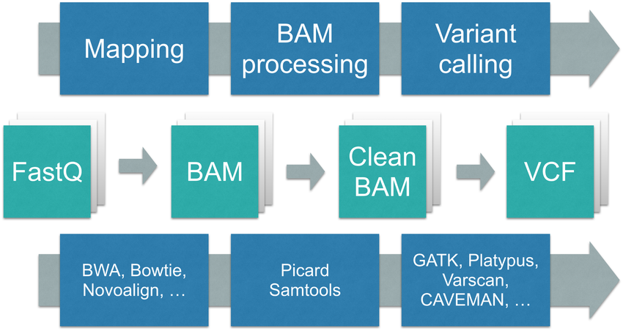
Resequencing Workflow

Slide 7
Sequence Trimming
Q = –10 log₁₀(P)

Slide 8
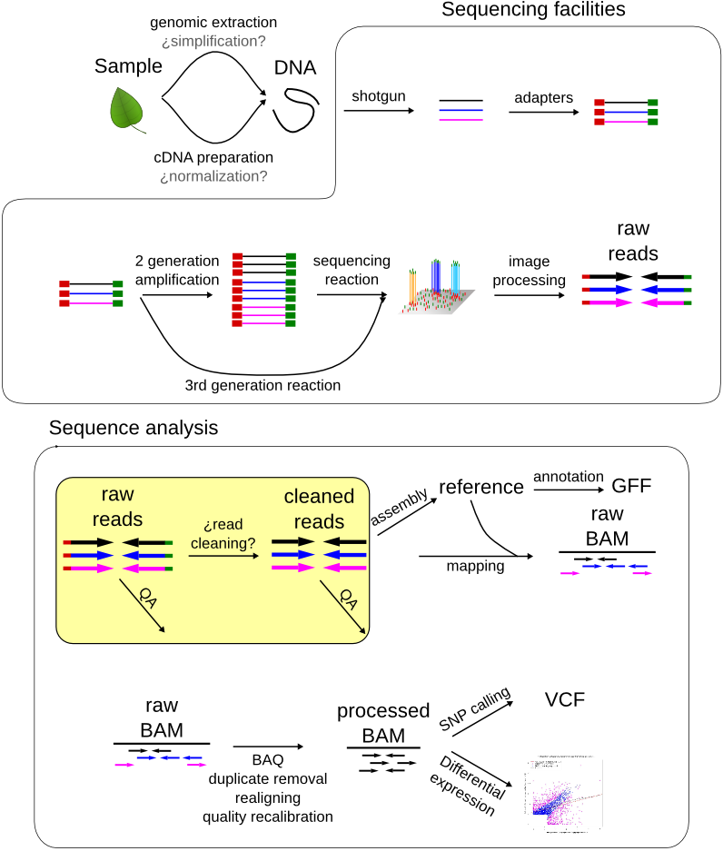

Slide 9
Sequence Trimming
Trimmomatic
java -jar ~/Trimmomatic-0.39/trimmomatic-0.39.jar PE -phred33 <input_forward.fq.gz> <input_reverse.fq.gz> <output_forward_paired.fq.gz> <output_forward_unpaired.fq.gz> <output_reverse_paired.fq.gz> <output_reverse_unpaired.fq.gz> ILLUMINACLIP:~/Trimmomatic-0.36/adapters/TruSeq3-PE.fa:2:30:10 SLIDINGWINDOW:4:20 MINLEN:36
java -jar ~/Trimmomatic-0.36/trimmomatic-0.36.jar SE -phred33 BS.cat.fq.trimmed BS.cat.fq.trimmed.trimo.out.1.20 ILLUMINACLIP:../Trimmomatic-0.36/adapters/TruSeq3-SE.fa:2:30:10 SLIDINGWINDOW:1:20 MINLEN:50
PE / SE
SLIDINGWINDOW:4:20 (windowsize, threshold)
Truseq3-PE.fa (adapter information of Hiseq)
/data5/KOICA/program/Trimmomatic-0.39/

Slide 10
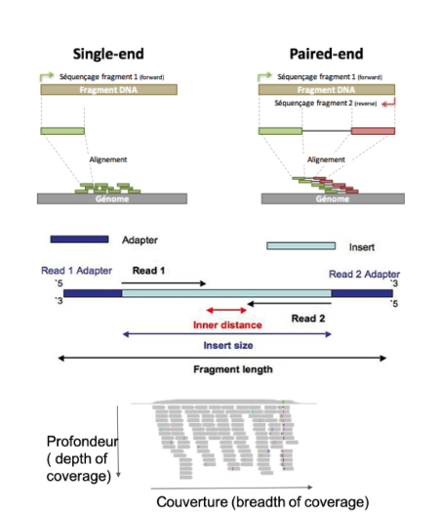
Notes:
java -jar ../program/Trimmomatic-0.39/trimmomatic-0.39.jar PE -phred33 Daewon_1.fastq.gz Daewon_2.fastq.gz Daewon_1_paired.fq.gz Daewon_2_paired.fq.gz Daewon_1_unpaired.fq.gz Daewon_2_unpaired.fq.gz ILLUMINACLIP:../program/Trimmomatic-0.39/adapters/TruSeq3-PE.fa:2:30:10 SLIDINGWINDOW:4:20 MINLEN:36

Slide 11
BWA indexing
BWA
Burrows-Wheeler Aligner
http://bio-bwa.sourceforge.net/
Aligning program
Indexing
bwa index <ref.fa>

Slide 12
Aligning
bwa mem <ref.fa> <fastq1> <fastq2> … | samtools view –bS - > <filename.bam>
bwa mem make sam file as output
| mean after
After the aligning, sam file is converted as bam file using samtools
Samtools option
-q mapping quality
/data2/ref/Gmax/assembly/Gmax_275_v2.0.fa
Notes:
bwa mem /data2/ref/Gmax/assembly/Gmax_275_v2.0.fa ../repository/trimmed/Daewon_1_paired.fq.gz ../repository/trimmed/Daewon_2_paired.fq.gz | samtools view -bs -q30 > D.bam

Slide 13
Sorting & indexing bam and Fasta indexing
samtools sort <in.bam> -o <out.sort.bam>
samtools index <out.sort.bam>
samtools faidx <ref.fa>

Slide 14
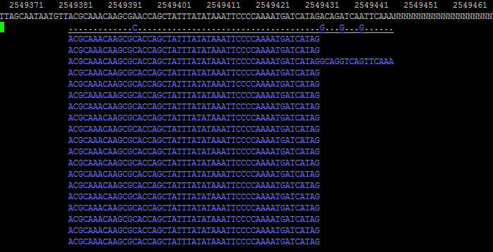
Tview
samtools tview <bamfile> <ref.fa>

Slide 15
Pileup or multiple pileup & variant calling
Pileup
samtools mpileup –f <ref.fa> -v -t DP,AD,ADF,ADR,SP,INFO/AD,INFO/ADF,INFO/ADR -u <in.bam> | bcftools call -Ov -mv -o variant.vcf
Multiple pileup
samtools mpileup –f <ref.fa> -v -t DP,AD,ADF,ADR,SP,INFO/AD,INFO/ADF,INFO/ADR -u -b bam_list | bcftools call -v -m -O v > variant.vcf
Notes:
samtools mpileup -f Gmax_275_v2.0.fa -v -t DP,AD,ADF,ADR,SP,INFO/AD,INFO/ADF,INFO/ADR -u -b bam_list | bcftools call -Ov -mv -o UV.chojam.variant.vcf

Slide 16
VCFtools common usage
vcftools ‘--options’--vcf <vcf_file> --out <outfile> --recode
--vcf or --gzvcf
You can use many options at the same time
All the options you can use are in the manual
https://vcftools.github.io/man_latest.html

Slide 17
Filtering INDEL
vcftools --gzvcf variant.vcf.gz --recode --out variant.vcf.gz.SNPs --remove-indels

Slide 18
Filtering by position
vcftools --vcf variant.vcf.gz.SNPs.recode.vcf --chr Chr01 --out variant.vcf.gz.Chr01 --recode
--not-chr
vcftools --vcf variant.vcf.gz.SNPs.recode.vcf--chr Chr01 --from-bp 300 --to-bp 1000000 --out variant.vcf.gz.Chr01 –recode
vcftools --vcf variant.vcf.gz.SNPs.recode.vcf --out overlap.vcf --recode --positions position_list.txt
position_list.txt (TAB separated file)

Slide 19
Other filtering options
--maf 0.05
--max-maf 0.3
--minQ 30
--minDP 3

Slide 20
Suggested command for filtering
vcftools --vcf variant.vcf --remove-indels --minQ 30 --minDP 5(or 3) --out variant.vcf.SNP.q30.d5 --recode
Minimum depth filtering
Mapping quality filtering
Remove indels

Slide 21
SNP typing
snpEff
java –Xmx4g –jar ~/snpEff/snpEff.jar -c <config file> -v <DB> <vcf_file> > <output file>
java -Xmx4g -jar ~/snpEff/snpEff.jar -c ~/snpEff/snpEff.config -v Oryza_sativa <vcffile> > <out_file>
You can check DB name in ~/snpEff/snpEff.config

Slide 22
Download DB for snpEff
java -jar snpEff.jar download -v Oryza_sativa

Slide 23
snpEff DB construction
GFF file is needed to contruct snpEff DB
Edit snpEff configure file
Make gm275 directory in ~/snpEff/data
Copy gff file into gm275 directory
java -jar snpEff.jar build -gff3 -v gm275

Slide 24
SNP typing
java -Xmx4g -jar ~/snpEff/snpEff.jar -c ~/snpEff/snpEff.config -v Gmax BS.bam.sort.vcf -ud 2000 > BS.bam.sort.vcf.type
Outfile
Genefile
Summary file
/data1/program/snpEff

