Slide 1
Information processing after resequencing

Slide 2
Sequence Trimming
Q = –10 log₁₀(P)

Slide 3
Sequence Trimming
Trimmomatic
java -jar jar ~/Trimmomatic-0.36/trimmomatic-0.36.jar PE -phred33 <input_forward.fq.gz> <input_reverse.fq.gz> <output_forward_paired.fq.gz> <output_forward_unpaired.fq.gz> <output_reverse_paired.fq.gz> <output_reverse_unpaired.fq.gz> ILLUMINACLIP:../Trimmomatic-0.36/adapters/TruSeq3-PE.fa:2:30:10 SLIDINGWINDOW:4:20 MINLEN:36
java -jar ~/Trimmomatic-0.36/trimmomatic-0.36.jar SE -phred33 BS.cat.fq.trimmed BS.cat.fq.trimmed.trimo.out.1.20 ILLUMINACLIP:../Trimmomatic-0.36/adapters/TruSeq3-SE.fa:2:30:10 SLIDINGWINDOW:1:20 MINLEN:50
PE / SE
SLIDINGWINDOW:4:20 (windowsize, threshold)
Truseq3-PE.fa (adapter information of Hiseq)

Slide 4
Mapping quality control
Common usage for Aligning
bwa mem <ref.fa> <fastq1> <fastq2> … | samtools view –bS - > <filename.bam>
-q 30
Mapping quality >= 30

Slide 5
Bam file status check
Samtools flagstat <bamfile>

Slide 6
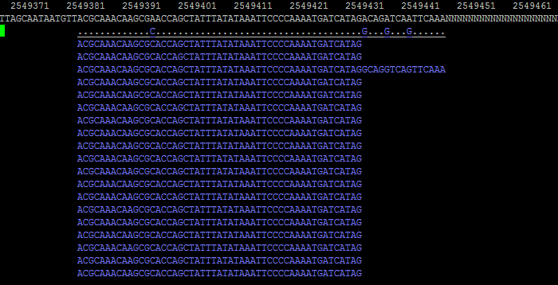
Tview
samtools tview <bamfile> <ref.fa>

Slide 7
VCFtools common usage
vcftools ‘--options’--vcf <vcf_file> --out <outfile> --recode
--vcf or --gzvcf
You can use many options at the same time
All the options you can use are in the manual
https://vcftools.github.io/man_latest.html

Slide 8
Filtering INDEL
vcftools --gzvcf variant.vcf.gz --recode --out variant.vcf.gz.SNPs --remove-indels

Slide 9
Filtering by position
vcftools --vcf variant.vcf.gz.SNPs.recode.vcf --chr Chr01 --out variant.vcf.gz.Chr01 --recode
--not-chr
vcftools --vcf variant.vcf.gz.SNPs.recode.vcf--chr Chr01 --from-bp 300 --to-bp 1000000 --out variant.vcf.gz.Chr01 –recode
vcftools --vcf variant.vcf.gz.SNPs.recode.vcf --out overlap.vcf --recode --positions position_list.txt
position_list.txt (TAB separated file)

Slide 10
Other filtering options
--maf 0.05
--max-maf 0.3
--minQ 30
--minDP 3

Slide 11
Suggested command for filtering
vcftools --vcf variant.vcf --remove-indels --minQ 30 --minDP 5(or 3) --out variant.vcf.SNP.q30.d5 --recode
Minimum depth filtering
Mapping quality filtering
Remove indels

Slide 12
Get statistical value (without --recode)
--freq
*.freq
--TsTv <window_size>
*.TsTv
--TsTv-summary
*.TsTv

Slide 13
Get statistical value (without --recode)
--site-pi
--window-pi <window_size>
--window-pi-step <step_size>
vcftools --vcf variant.vcf.gz.SNPs.recode.vcf --out test --window-pi 10000 --window-pi-step 1000
--weir-fst-pop <file_name>
--fst-window-size <window_size>
--fst-window-step <step_size>
Vcftools --vcf <vcf_file> --weir-fst-pop bam_list_A --weir-fst-pop bam_list_B --fst-window-size 100000 --fst-window-step 10000 --out <out_file>

Slide 14
Get statistical value (without --recode)
--TajimaD <window_size>
--het

Slide 15
VCF comparison
--diff

Slide 16
SNP typing
snpEff
java –Xmx4g –jar ~/snpEff/snpEff.jar -c <config file> -v <DB> <vcf_file> > <output file>
java -Xmx4g -jar ~/snpEff/snpEff.jar -c ~/snpEff/snpEff.config -v Oryza_sativa <vcffile> > <out_file>
You can check DB name in ~/snpEff/snpEff.config

Slide 17
Download DB for snpEff
java -jar snpEff.jar download -v Oryza_sativa

Slide 18
snpEff DB construction
GFF file is needed to contruct snpEff DB
Edit snpEff configure file
Make gm275 directory in ~/snpEff/data
Copy gff file into gm275 directory
java -jar snpEff.jar build -gff3 -v gm275

Slide 19
SNP typing
java -Xmx4g -jar ~/snpEff/snpEff.jar -c ~/snpEff/snpEff.config -v gm275 BS.bam.sort.vcf -ud 2000 > BS.bam.sort.vcf.type
Outfile
Genefile
Summary file

Slide 20
VCF to tabular format
Please use after filtering vcf
python make_tabular.py variant.vcf.type > variant.vcf.type.tabular

