Slide 1
Day 4. Map construction
Sangrea Shim

Slide 2
Index
Day 4
Map Construction
Reformat the VCF to JoinMap input
JoinMap usage

Slide 3
JoinMap4
Calculate recombination frequency
Detect linked markers or loci
Windows based software
License which is not free obligated to analyze more than 1000 markers or loci

Slide 4
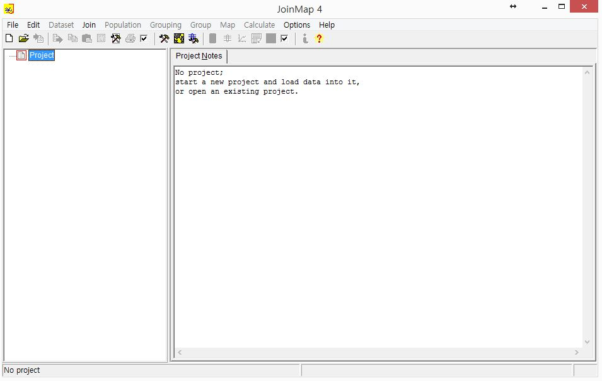
Map Construction
Execute JoinMap

Slide 5
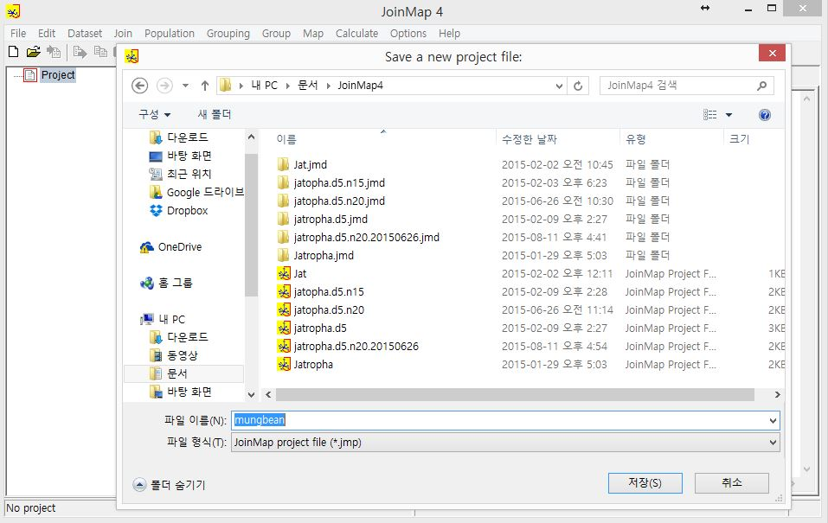
Map Construction
Open new project
Naming on that project as you wish

Slide 6
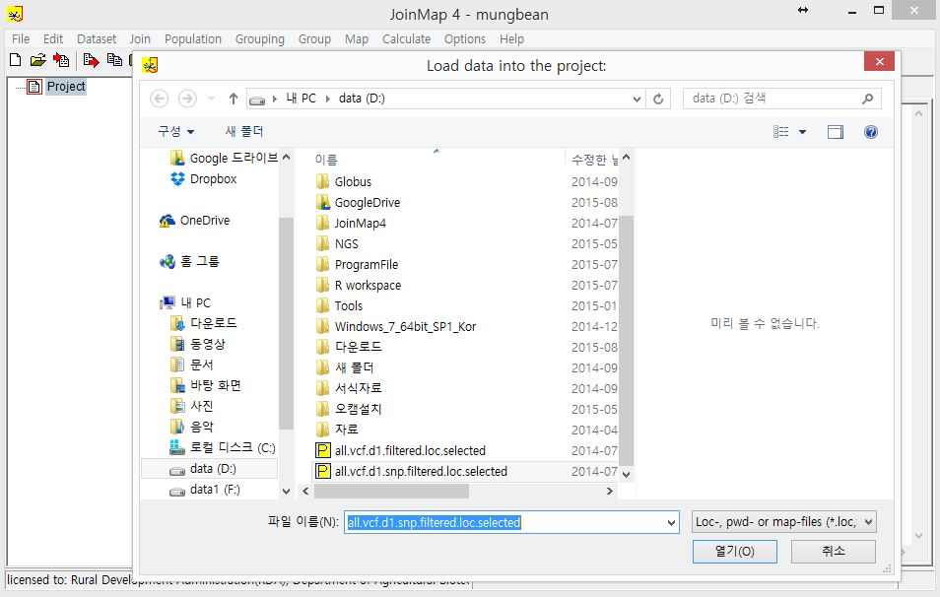
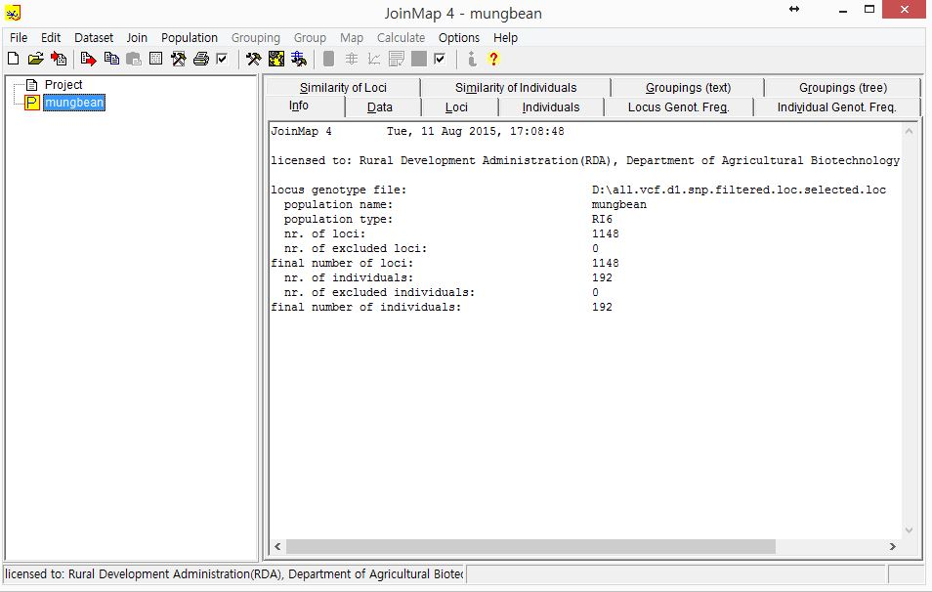
Map Construction
Load the transformed LOC file

Slide 7
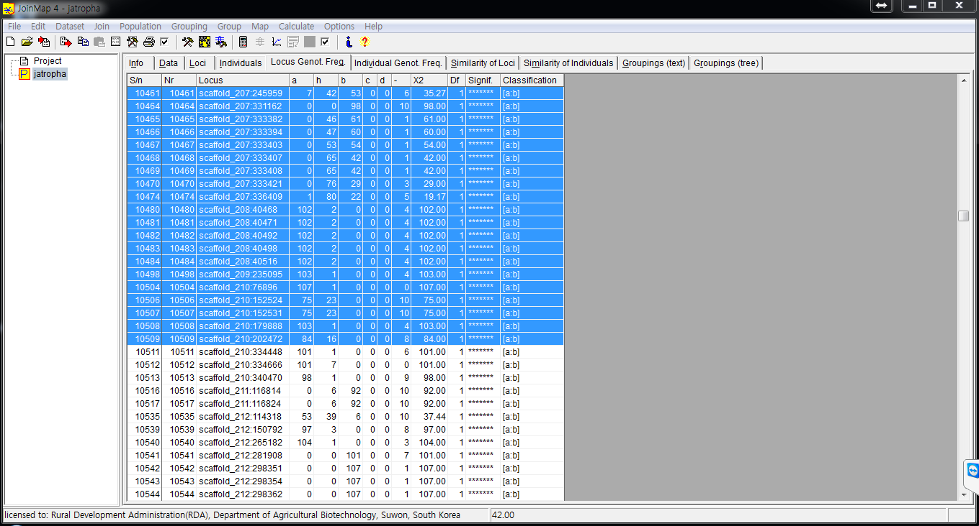
Map Construction
In locus genotype freq tab
Push calculator button
Chi-square test will be done for each loci

Slide 8
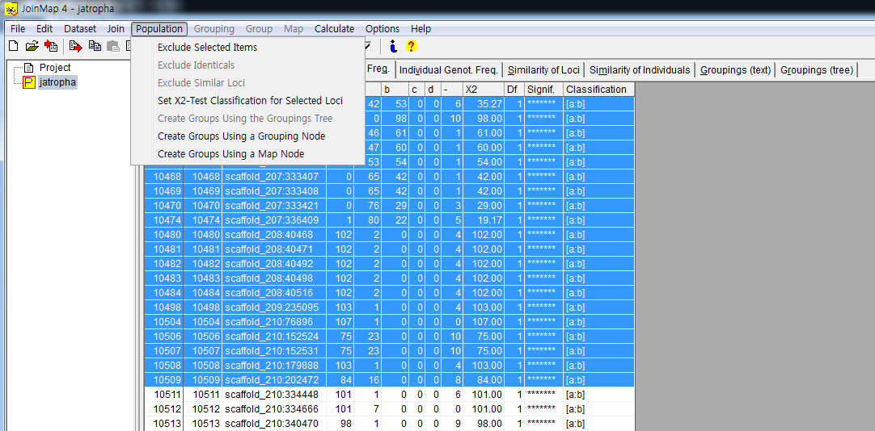
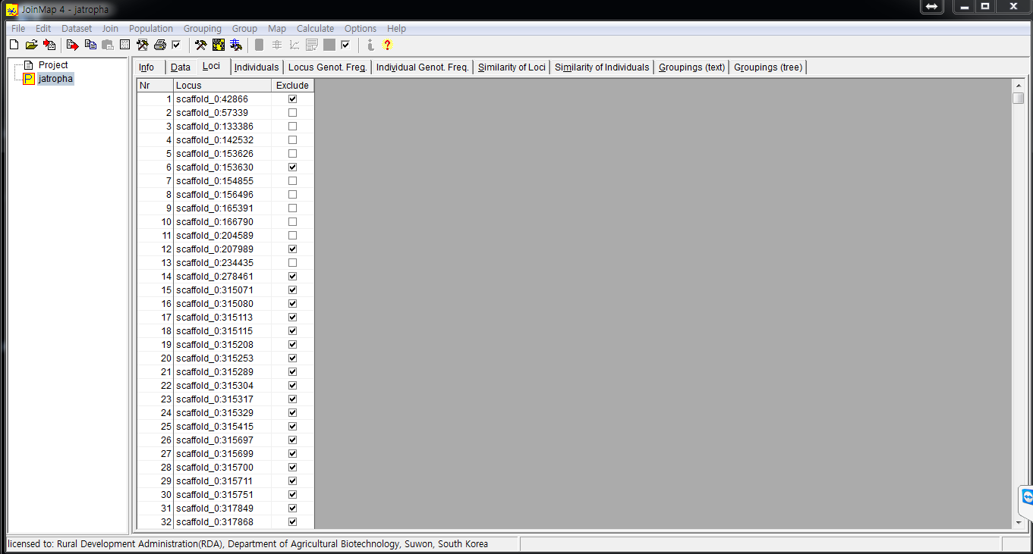
Map Construction
Exclude loci which is higly significant
Segregation distortion

Slide 9
Map Construction
In individual genotype freq tab
Push calculator button
To avoid cloned genotype information

Slide 10
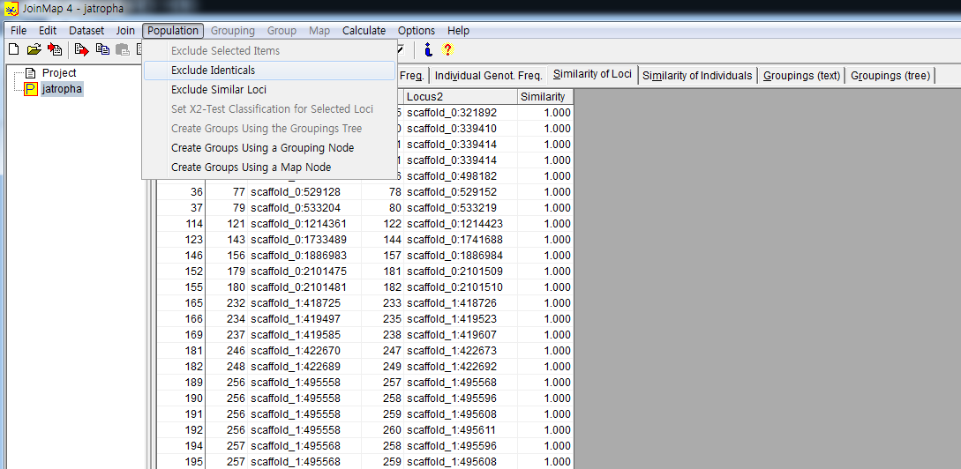
Map Construction
In similarity of loci tab
Push calculator button
Exclude identical/highly similar loci using “exclude identical/selected” function in population menu
Exclude identical loci is preferred

Slide 11
Map Construction
In similarity of individual tab
Push calculator button
Exclude identical/similar individuals

Slide 12
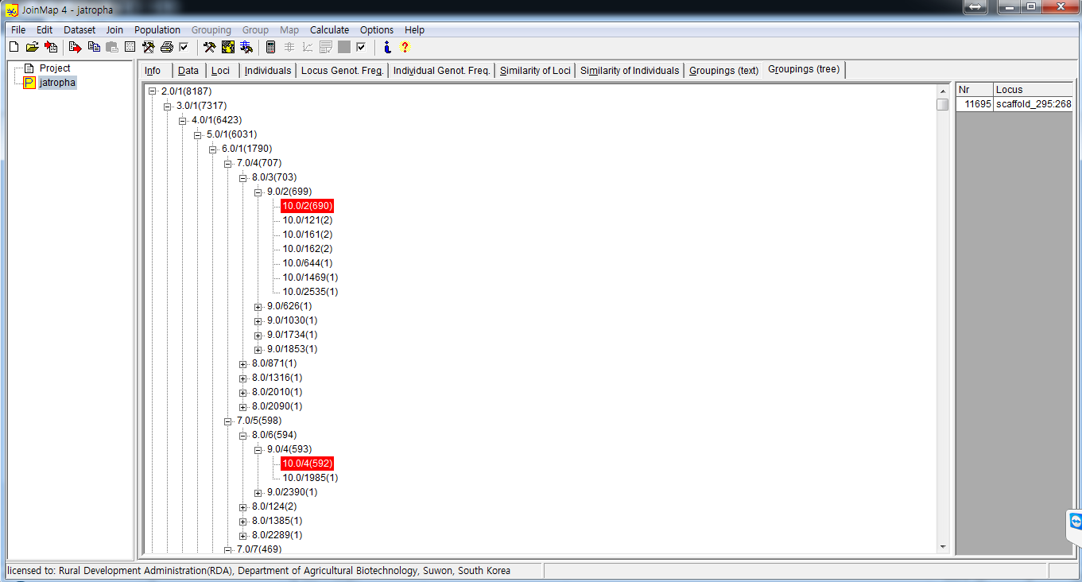
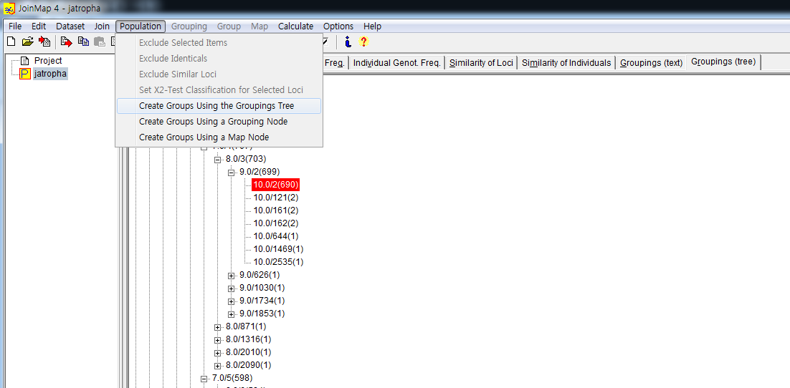
Map Construction
In groupings (tree) tab
Push calculator button
Select groups using space bar
Create Groups Using Groupings Tree
LOD score 3 is threshold for linkage

Slide 13
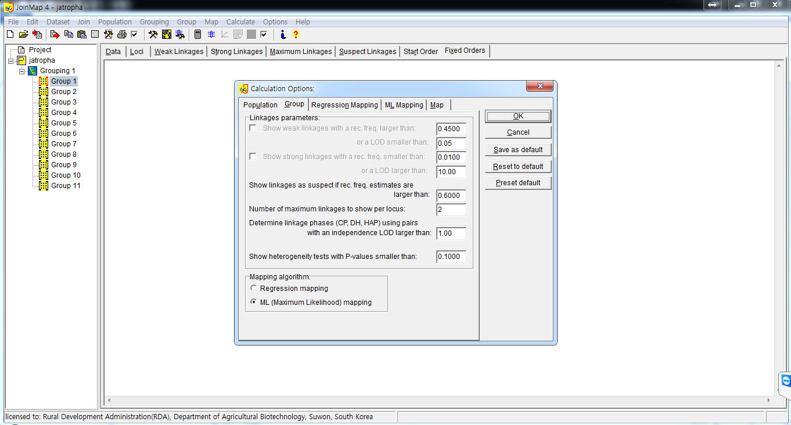
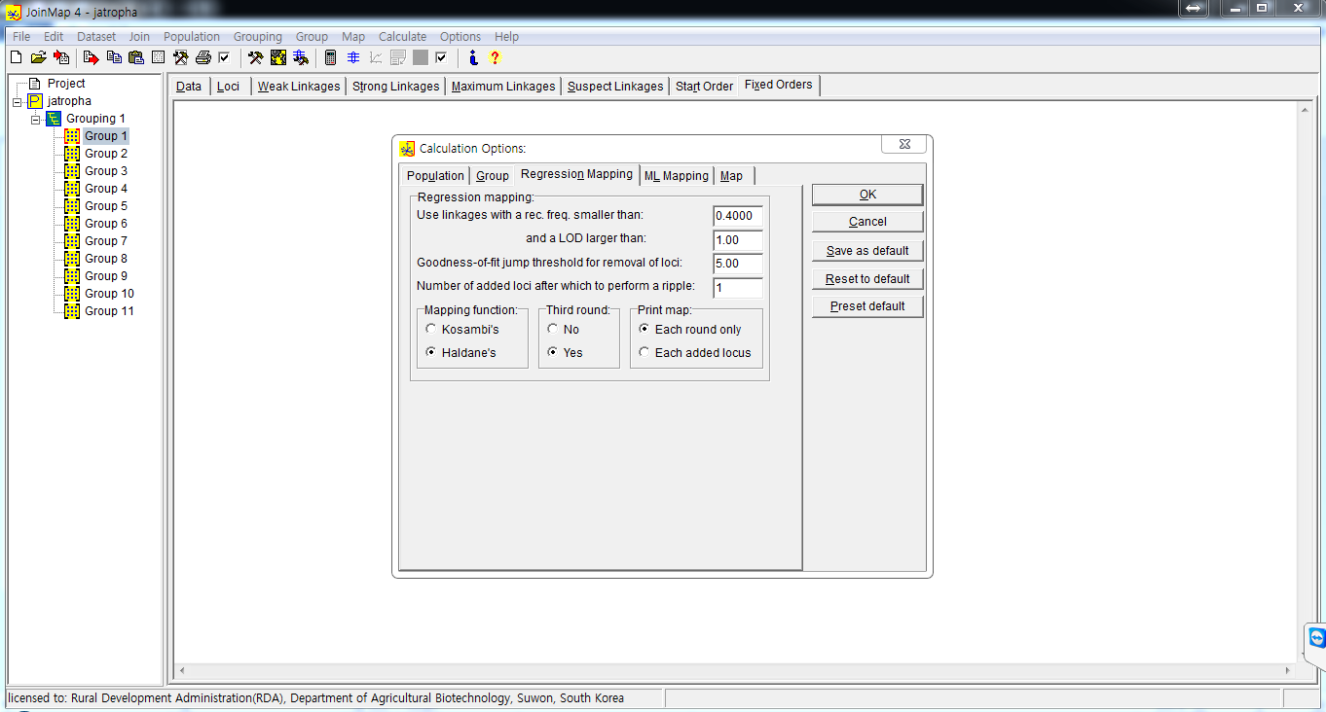
Map Construction
Linkage groups will be shown at left side
Calculate genetic map for each LG
Regression mapping: Use Kosambi’s function
ML mapping: Use Haldane’s function

Slide 14
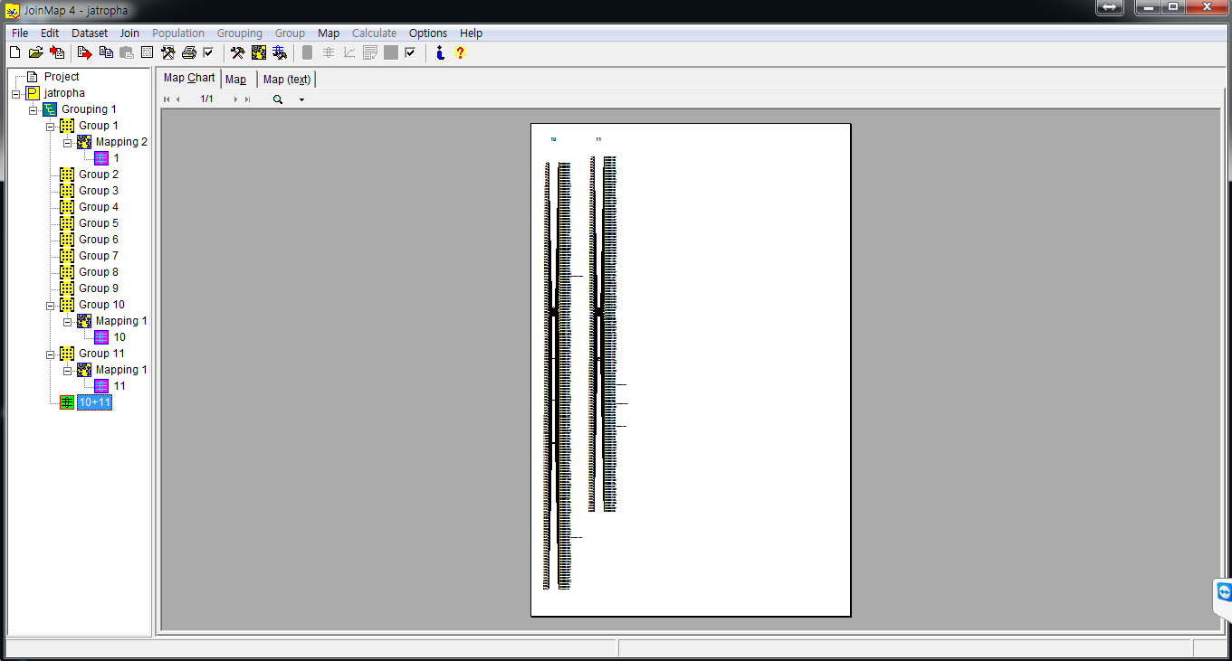
Map Construction

Slide 15
That’s it for this course
Q & A

Slide 16
Visit webpage for our lab

