Slide 1
Python study
1st day
Python variable types and basic functions

Slide 2
Homework check!

Slide 3
Variable
What is the Variable?
$Y=πx^{2}$
$A=πr^{2}$
$Area= π{(radius)}^{2}$
These three formula are same
although their variable names are different
We can set the variable names whatever you want
But! We have to know
In A = B, A is the name of variable and B is the value
It is called as variable setting
If you did not set variable, you cannot use them

Slide 4
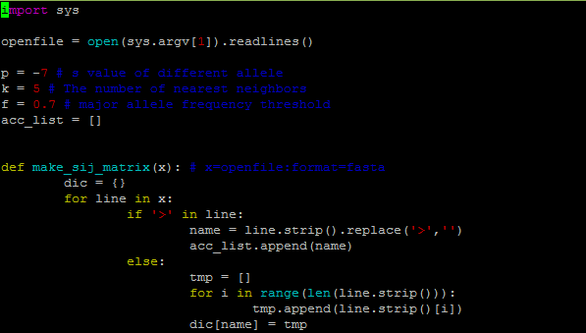
Variable

Slide 5
Variable type
String type
All the characters are string type
‘a’, ‘b’, ‘c’, ‘d’, ‘0’, ‘1’, ‘2’, ‘3’, ‘0.1’…
You have to use ‘’ or “” for string type
A : variable A
‘A’ : string value A
Special character(\ = ₩)
‘\n’ : newline character
‘\t’ : tab
‘\’’ : ‘
‘\”’ : “
‘\\’ : \

Slide 6
Variable type
Integer type
All the integers are integer type
1, 2, 3, 4, 100, 72038, 900223
Float type
Represent decimal number or fractional number
1/3, 0.23, 1.8, 3.141592

Slide 7
Characteristics of Variable
Cannot use add between str and int type variable
‘Crop’ + ‘ Genomics’ = ‘Crop Genomics’
‘Crop’ + ‘4555’ = ‘Crop4555’
‘880’ + ‘4555’ = ‘8804555’
880 + 4555 = 5435
‘880’ + 4555 = error
‘Crop’ + 4555 = error
Between str and float also.

Slide 8
Characteristics of Variable
If you use float at least once, that variable will be float
5/2 = 2
1+2 = 3
5.0/2 = 2.5
5/2.0 = 2.5
1.0+2 = 3.0

Slide 9
Characteristics of Variable
You can multiply string variable
2*3 = 6
‘2’*3 = 222
‘hello’*3 = hellohellohello
Hello*3 vs. ‘Hello’*3

Slide 10
Characteristics of Variable
You can use these kind of symbols in integer and float type variable
+, -, *, /
//, %

Slide 11
Other variables
List
Dictionary

Slide 12
Other variables
List
Is set by []
The list of other values or variable
List_a = [1,2,’a’,’b’,[a,b]]
List also can value of list
Can get empty value
List_b = []

Slide 13
Other variables
Dictionary
Is set by {}
Like a dictionary, had keys and values
Dic_a = {‘English’:‘영어’} →Dic_a[‘English’] = ‘영어’
One key only have one value whatever, list, string, integer or dictionary
Usage)
Dic_amino_acid = {‘ATG’:‘Met’, ‘TGA:*’}
Dic_amino_acid = {} Dic_amino_acid[‘ATG’] = ‘Met’
Key = [‘ATG’,’TGA’] value = [‘Met’, ‘*’] Dic_amino_acid = dict(zip(key,value))

Slide 14
Start python coding
vi filename.py
Python code files have .py as extension

Slide 15
Basic functions(함수)
What is the fuction(함수)?
Already set fuction(기능) by other programmer
Ex) print, if, for, open, etc..
Print (standard output function)
Function for print something
Usage)
Print a
Print ‘a’
Print ‘a’*3
Print 3*4
Print print with newline character
Print ‘a\n’

Slide 16
Basic functions
Standard input functions
Input
For integer
Raw_input
For string
Usage)
A = input(“enter some integers”)
B = raw_input(“enter some words”)

Slide 17
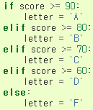
Basic functions
If
For judgment
If conditional sentence were satisfied, some command were executed
If not, the other command were executed
Meaning | Math Symbol | Python Symbols
Less than | < | <
Greater than | > | >
Less than or equal | ≤ | <=
Greater than or equal | ≥ | >=
Equals | = | ==
Not equal | ≠ | !=
Contain |  | in
Not contain |  | not in

Slide 18
Basic functions
True
False
If
if
…
elif …
else
Status A
Status B
Status C

Slide 19
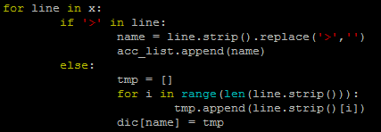
Basic functions
Functions for loop
For
Useful for limited loop
Usage) For variable_name in list_name:
range()
make list of integer
Ex) range(2) = [0,1] range(1,5) = [1,2,3,4] range(1,5,2) = [1,3]
len()
Calculate length
Ex) len(‘ABC’) = 3 len([1,2]) = 2

Slide 20
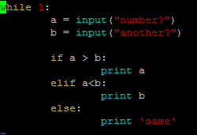
Basic functions
Functions for loop
While
Useful for infinite loop
Usage while conditional_sentence:
If conditional sentence is true, loop are work.
While 1 mean always true, so it is infinite loop

Slide 21
Basic functions
break & continue
They are always used with if and loop functions
break
If conditional sentence is true, the loop will be terminated
continue
If conditional sentence is true, that element of loop will be passed

Slide 22
Homework
"This is sequence file"을 화면에 출력하시오.
standard input으로 (즉,화면에서) 임의의 문자열 입력받아 화면에 출력하시오.
두 정수를 standard input으로 입력받아 변수 a와 b에 저장하고 이들의 합을 변수 c에 저장한 후 결과를 출력하시오.
두 수를 입력하고 둘 중에 큰 수를 출력해주는 프로그램을 작성하시오.
Standard input으로 3-base codon을 입력받아서 아미노산으로 출력하시오.
4번의 문제에서 입력을 계속 받을 수 있도록 수정하시오.

