Slide 1
Day 3. Advanced python practice
SANGREA SHIM
TAEYOUNG LEE

Slide 2
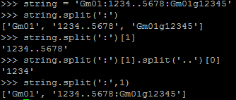
Function for string
.split()
Divide string by delimiter
Usage)

Slide 3
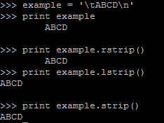
Function for string
.strip()
Remove both side gap of string
.rstrip() – right strip
.lstrip() – left strip
Usage)

Slide 4
Function for string
.replace(‘a’,’b’)
Replace ‘a’ to ‘b’
Usage)

Slide 5
Function for string
.zfill()
Filling 0
Ex) 001, 0035
Usage)

Slide 6
Function for list
.append()
Add elements to end of list
Usage)

Slide 7
Function for list
.insert()
Add elements to specific location
Usage)

Slide 8
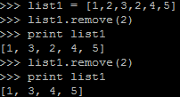
Function for list
.remove()
Remove element
Usage)

Slide 9
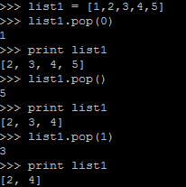
Function for list
.pop()
Retrieve and remove element
Usage)

Slide 10
Function for list
.join()
Join elements of list as string
Usage)

Slide 11
Function for list
set() & list()
Remove redundancy
Usage)

Slide 12
Function for dictionary
.keys() & .values()
Retrieve keys and values of dictionary as lists
Usage)

Slide 13
File input & output
open()
Usage)
open(file_path, ‘w’) for writing
open(file_path, ‘r’) for reading
Reading file
.read()
.readline()
.readlines()

Slide 14
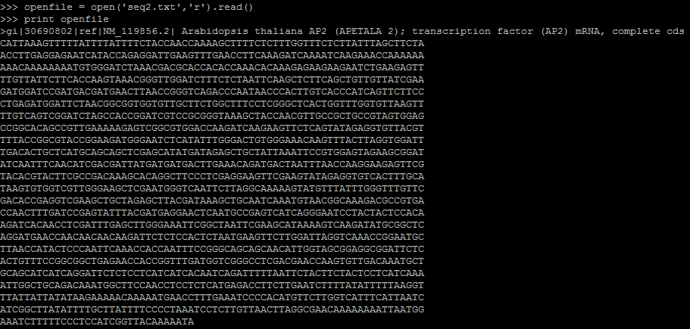
File input & output
.read() – read entire file

Slide 15
File input & output
.readline() – read one line for each command

Slide 16
File input & output
.readlines() – read all line as list

Slide 17
File input & output
Use .readlines() with for loop

Slide 18
File input & output
File write

Slide 19
Practice
Make a file, “title.txt”, which contains “This is a sequence file”
Open the “title.txt” and print first row. Ex) “The first line is : ~”
Open /data2/python_study/ap2.fa and print it using while Hint) you can use .readline()
Same with problem 3, but, do not print, save as a file, “seq2.txt”
Same with problem 4, but, print second word. Ex) “The second word is : “
Same with problem 3, but, you should set a variable ‘title’ save the first line of file and from the second line to the end should be saved into variable seq without newline character. Then, print title and seq variables
Get the codon and amino acid pairs repeatedly by standard input and loop (infinitely and if you entered ‘XXX’, the program is terminated). Then get the codon by standard input again as a key and print the value of that key
Using variable seq in problem 6, translate all the nucleotide sequences to amino acid sequence
Get a number by standard input and using variable seq in problem 6 or result of problem 8, print the next three amino acid from the number you entered Ex) if you has PheMetGlyGlnLysTrp and you enter 3, you have to get this result “The next three amino acids are Gln, Lys, Trp”
Enter amino acid and print the position of that amino acid Ex) if you has PheMetGlyGlnLysTrpPhe and you enter ‘Phe’, you have to get this result “The amino acid is found at 1, 7”

Slide 20
Converting multi-VCF to JoinMap LOC
Based on the python course
Make converting script

Slide 21
That’s it for today
Q & A

